Slide 1
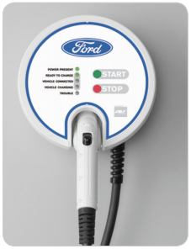

ford CHARGING Station Customer NEEDS
EDU Project
karacankos@gmail.com
https://www.linkedin.com/in/omer-karacan/
https://www.instagram.com/karacanos/

Slide 2
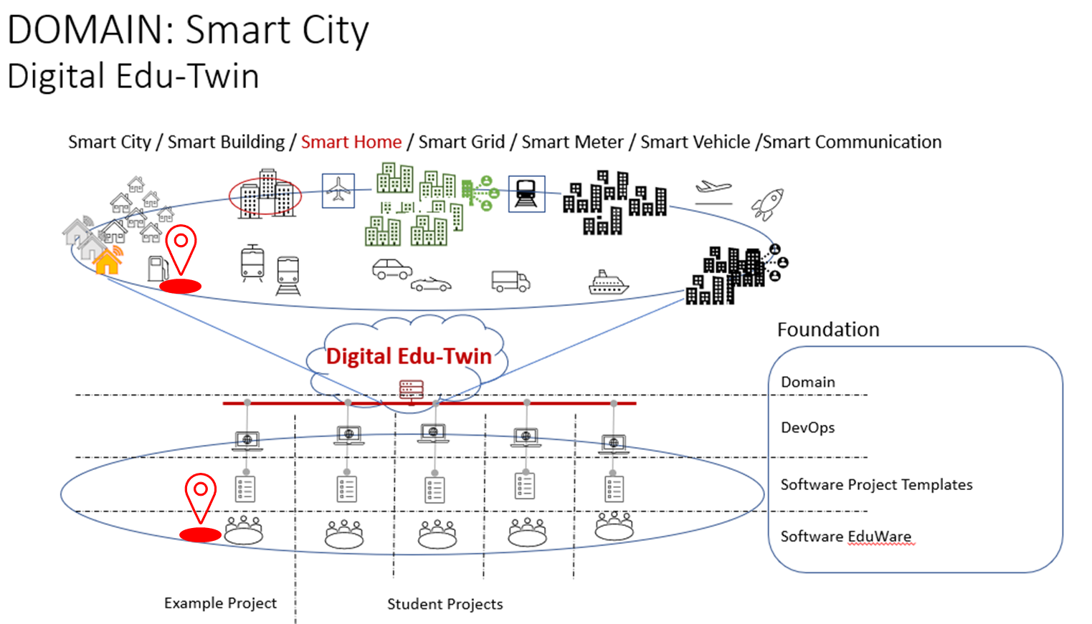

Project Context

Slide 3
HOW TO TEST

Slide 4
Car charging state State/Event Table test cases
REVISIT
Test Case | TC #1 | TC #2 | TC #3 | TC #4
Start state | Ready to charge | Vehicle connected | vehicle charging | Vehicle connected
Event/Input | Vehicle_connected | Start_charging | Stop_charging | Vehicle_disconnected
Expected Output | «Vehicle connected» | «vehicle charging» | «Vehicle connected» | «Vehicle disconnected»
End state | Vehicle connected | vehicle charging | Vehicle connected | Ready to charge

Slide 5
BACKYARD
Wichtige Informationen

Slide 6
Notes
FORD – Charging Station
https://www.evsolutions.com/Upload/Product/635652466512570000.pdf

